Slide 1
CORBA
Shivaraj Alagond
Credits: Mayank Acharya

Slide 2
COMMON OBJECT REQUEST BROKER ARCHITECTURE (CORBA)
CORBA is designed to facilitate the communication between the systems irrespective of the platform.
CORBA is a standard defined by the Object Management Group(OMG) in the year 1991.
It enables the interoperability between systems irrespective of operating system , programming language and hardware.

Slide 3
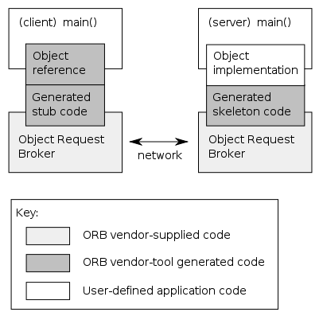
CORBA STRUCTURE:

Slide 4
OVERVIEW OF STRUCTURE:
Server: It will have one or more CORBA objects
CORBA Objects: Virtual entity capable of being located by an ORB and having client requests invoked on them
Client: Obtain the object reference & invokes as if it is invoking operation on object instance.
Object Request Broker(ORB):
It’s implemented both the side , it takes care of routing all the request from client to server and response from server to client.
Client-side, it contains interface definition.
Server-side, it handles activation/deactivation of objects.

Slide 5
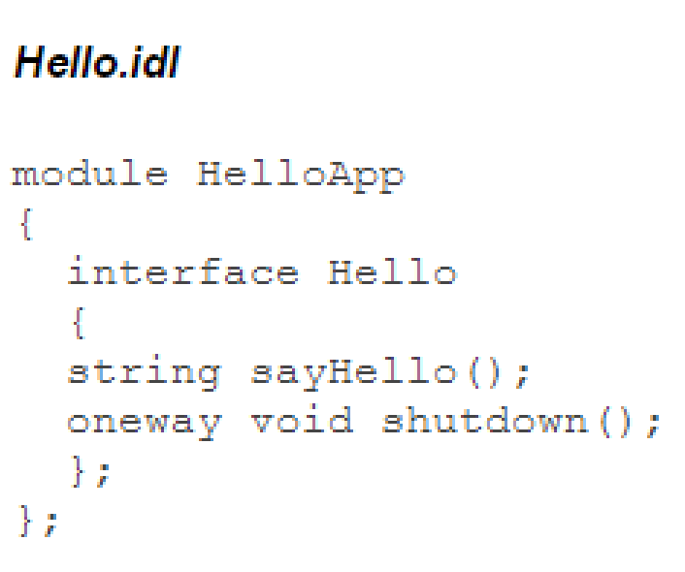
STEP-1:RUN CORBA ON SYSTEM
1. Create file with .idl extension inside java project directory.

Slide 6
By default, the operations in Interface Definition Language are Synchronous
Client is blocked after invoking an operation until the object has processed the operation and returned a value.
Oneway facilitates to change the invocation semantics
Client will not be blocked when the operation has oneway keyword
It cannot return a value
If oneway operation fails, the client will never know

Slide 7
STEP-1: CONTINUE
Some common variable type for IDL:
boolean
string
any
char
float
TRUE
FALSE

Slide 8
STEP-2
2. Compile that IDL file using following command on cmd.
Idlj –fall Hello.idl
3. This will generate both client side and server side bindings.
4. Once you successfully run this command, it will create a folder which has 6 following files.
HelloPOA.java -> Server Skeleton
_HelloStub.java -> Client Stub
Hello.java -> java version of our idl interface file
HelloHelper.java -> this cast object reference to their proper types [ ex: narrow()]
HelloHolder.java -> it holds public instance of type Hello ( in or inout type)
HelloOperations.java -> it contains methods that declared in interface.

Slide 9
STEP-3: SERVER-SIDE IMPLEMENTATION (1)
//HelloImpl.java – servant: programming language entity that implements one or more CORBA objects
import HelloApp.*;
import org.omg.CosNaming.*; // will use for Naming Service
import org.omg.CosNaming.NamingContextPackage.*; //contains special exceptions thrown by the naming service
import org.omg.CORBA.*;
import org.omg.PortableServer.*; // Classes required for the Portable server inheritance model
import org.omg.PortableServer.POA;

Slide 10
STEP-3: SERVER-SIDE IMPLEMENTATION (2)
import java.util.Properties; // properties to initiate the ORB
class HelloImpl extends HelloPOA {
private ORB orb;
public void setORB(ORB orb_val) {
orb = orb_val;
}
// implement sayHello() method
public String sayHello() {
return "\nHello world !!\n";
}
// implement shutdown() method
public void shutdown() {
orb.shutdown(false);
} }

Slide 11
STEP-3: SERVER-SIDE IMPLEMENTATION (3)
public class HelloServer {
public static void main(String args[]) {
try{
// create and initialize the ORB
ORB orb = ORB.init(args, null);
// get reference to rootpoa & activate the POAManager (It allows an object implementation to function with different ORBs, hence the word portable)
POA rootpoa = POAHelper.narrow(orb.resolve_initial_references("RootPOA"));
rootpoa.the_POAManager().activate();
// create servant and register it with the ORB
HelloImpl helloImpl = new HelloImpl();
helloImpl.setORB(orb);

Slide 12
STEP-3: SERVER-SIDE IMPLEMENTATION (4)
// get object reference from the servant
org.omg.CORBA.Object ref = rootpoa.servant_to_reference(helloImpl);
Hello href = HelloHelper.narrow(ref);
// get the root naming context
// NameService invokes the name service
org.omg.CORBA.Object objRef =
orb.resolve_initial_references("NameService");
// Use NamingContextExt which is part of the Interoperable
// Naming Service (INS) specification.
NamingContextExt ncRef = NamingContextExtHelper.narrow(objRef);

Slide 13
STEP-3: SERVER-SIDE IMPLEMENTATION (5)
// bind the Object Reference in Naming
String name = "Hello";
NameComponent path[] = ncRef.to_name( name );
ncRef.rebind(path, href);
System.out.println("HelloServer ready and waiting ...");
// wait for invocations from clients
orb.run();
}
catch (Exception e) {
System.err.println("ERROR: " + e);
e.printStackTrace(System.out);
}
System.out.println("HelloServer Exiting ...");
} }

Slide 14
SERVER-SIDE CODE: SUMMARY
The HelloServer class has the server's main() method, which:
Creates and initializes an ORB instance
Gets a reference to the root POA and activates the POAManager
Creates a servant instance (the implementation of one CORBA Hello object) and tells the ORB about it
Gets a CORBA object reference for a naming context in which to register the new CORBA object
Gets the root naming context
Registers the new object in the naming context under the name "Hello"
Waits for invocations of the new object from the client

Slide 15
STEP-4: CLIENT-SIDE IMPLEMENTATION (1)
//HelloClient.java
import HelloApp.*;
import org.omg.CosNaming.*;
import org.omg.CosNaming.NamingContextPackage.*;
import org.omg.CORBA.*;
public class HelloClient
{
static Hello helloImpl;

Slide 16
STEP-4: CLIENT-SIDE IMPLEMENTATION (2)
public static void main(String args[])
{
try{
// create and initialize the ORB
ORB orb = ORB.init(args, null);
// get the root naming context
org.omg.CORBA.Object objRef =
orb.resolve_initial_references("NameService");
// Use NamingContextExt instead of NamingContext. This is
// part of the Interoperable naming Service.
NamingContextExt ncRef = NamingContextExtHelper.narrow(objRef);

Slide 17
STEP-4: CLIENT-SIDE IMPLEMENTATION (3)
// resolve the Object Reference in Naming
String name = "Hello";
helloImpl = HelloHelper.narrow(ncRef.resolve_str(name));
System.out.println("Obtained a handle on server object: " + helloImpl);
System.out.println(helloImpl.sayHello());
helloImpl.shutdown();
} catch (Exception e) {
System.out.println("ERROR : " + e) ;
e.printStackTrace(System.out);
}
}}

Slide 18
CLIENT-SIDE CODE: SUMMARY
Creates and initializes an ORB
Obtains a reference to the root naming context
Looks up "Hello" in the naming context and receives a reference to that CORBA object
Invokes the object's sayHello() and shutdown() operations and prints the result

Slide 19
STEP-5: RUN THE PROGRAM THROUGH CMD
1. Compile all the files: javac *.java HelloApp/*.java
2. Run ORBD through cmd: start orbd -ORBInitialPort 1050
3. Start Server: start java HelloServer -ORBInitialPort 1050 -ORBInitialHost localhost
4. Start Client: java HelloClient -ORBInitialPort 1050 -ORBInitialHost localhost
When the client is running, you will see a response such as the following on your terminal: Obtained a handle on server object: IOR: (binary code) Hello World! HelloServer exiting...

Slide 20
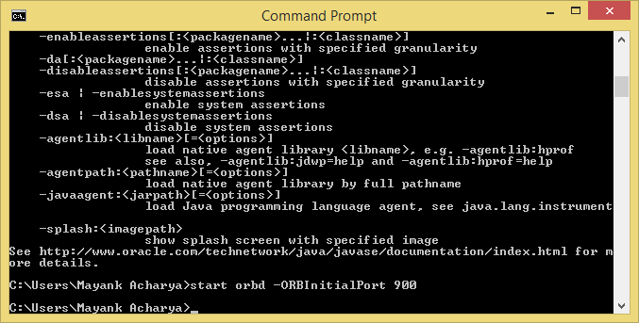

Slide 21
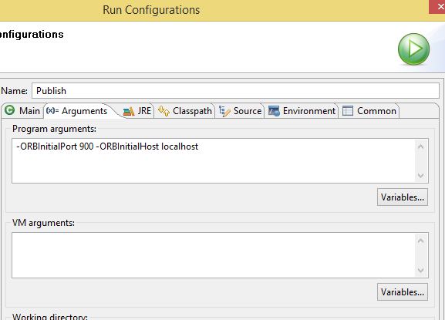
STEP-5: RUN THE PROGRAM THROUGH ECLIPSE

Slide 22
REFERENCE LINK:
Oracle CORBA Tutorial:
http://docs.oracle.com/javase/7/docs/technotes/guides/idl/jidlExample.html
CORBA ‘Hello World’ using Java:
http://www.ejbtutorial.com/programming/tutorial-for-corba-hello-world-using-java

